Slide 1
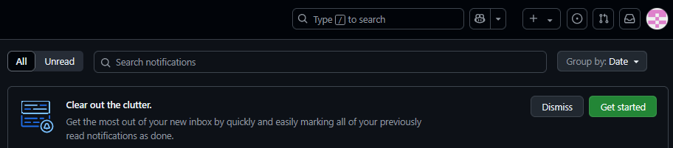
Submitting Assignment 4
1. Login to GitHub & accept invitation as collaborator
Find invitation to collaborate in Notifications

Slide 2
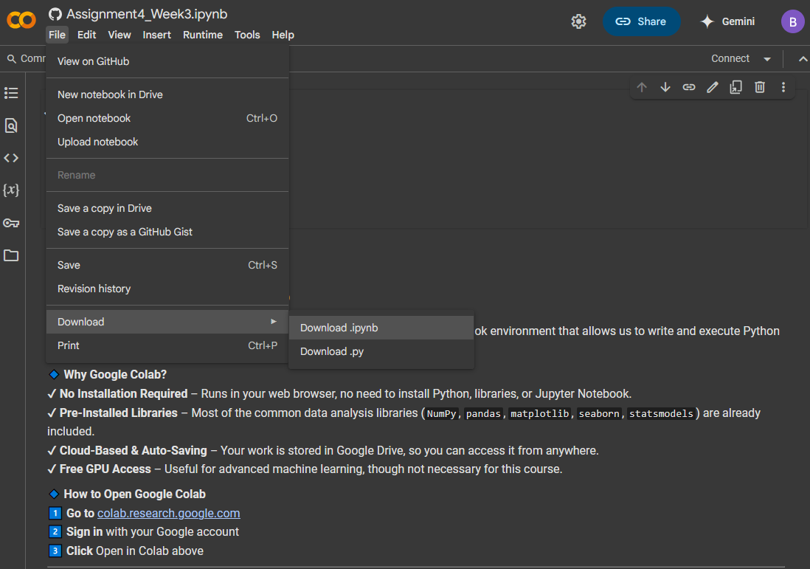
2. After completing the assignment in google colab, go to File -> Download -> Download .ipynb

Slide 3
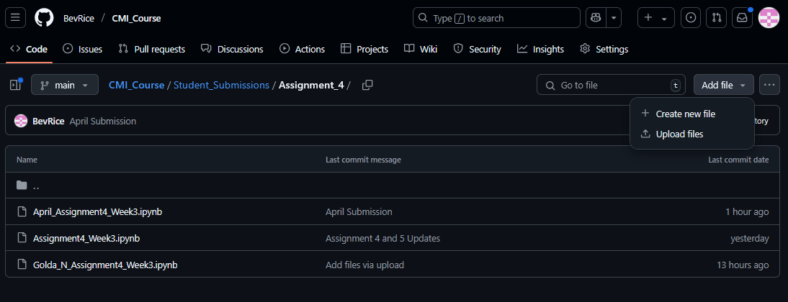
3. Go to the assignment submissions folder and click “Add File” then “Upload Files”

Slide 4
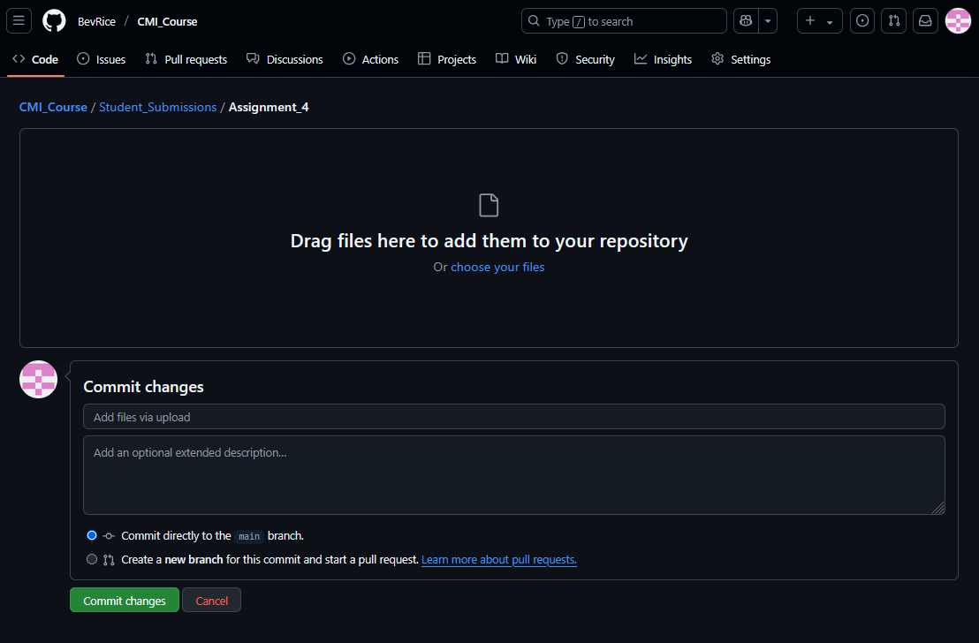
4. Drag and drop the file into GitHub or click on "choose your files“ and select your ipynb file; please make sure the file name has your first or last name in it otherwise it may overwrite another's assignment

Slide 5
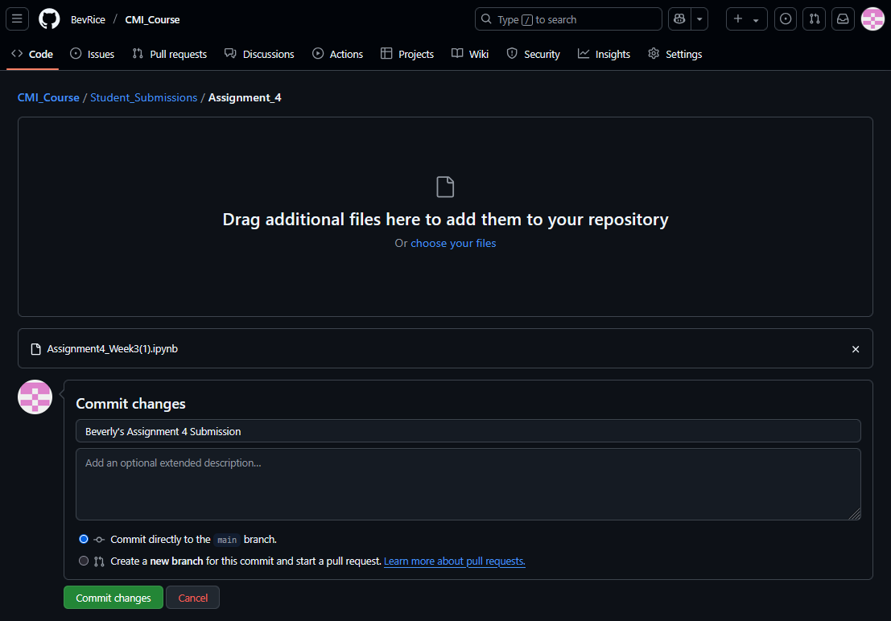
5. Add a comment under "Commit changes" where it says "Add file via upload"; this comment can be "Student X Assignment Y Submission“; then click “Commit changes”
File will show up here if uploaded correctly

